Slide 1
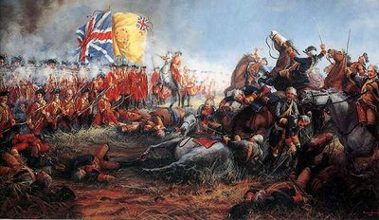
Carnatic Wars
The Carnatic Wars were a series of military conflicts in the middle of the 18th century between the French East India Company and the British East India Company, including numerous nominally independent rulers.

Slide 2
Total three wars faught between French and British in this Deccan region.
First Carnatic War (1746-48)
Second Carnatic War (1749–1754)
Third Carnatic War (1757–1763)
Main Reasons for these wars
The First and Third Carnatic Wars were essentially reflection of two international wars - War of the Austrian Succession (1740-48), and the Seven Year's War (1756-1763) respectively
The British and the French, both were eager to monopolize the Indian trade
The Internal(both Military & Political) weakness of Native rulers.

Slide 3
First Carnatic War (1746-48)
Background of the war
General decline in central control over the empire after the death of Aurangazeb, several erstwhile Mughal colonies revolted.
Carnatic was ruled by Nawab Dost Ali, under the legal purview of the Nizam of Hyderabad.
Dost Ali's death sparked a power struggle between his son-in-law Chanda Sahib and the Nizam's nominee, Anwar-ud-Din.
The British enlisted the help of Anwar-ud-Din to oust Joseph François Dupleix and the French from Madras.

Slide 4
As governor of the French East India Company, Marquis Joseph-François Dupleix sought to establish a French colony in India.
Immediately upon his arrival in India, he organized Indian recruits under French officers for the first time
Position of Carnatic
Carnatic was under the authority of Nawab of Carnatic( under Mughul)
In 1741 Marathas killed Carnatic ruler Dost Ali and captured his son –in- law Chanda Sahib-
In the absence of ruler Nizam of Hyderbad sent Anwar –ud- Din to adorned as Nawab
By1748 Chanda Shaib was released by Marathas-now Chanda Shaib claimed the nawabship

Slide 5
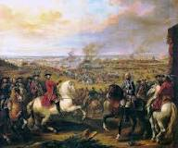
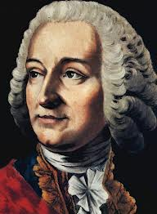
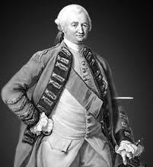
First Carnatic War Causes
Causes
1. War of Austrian Succession in Europe
(1740-48)
2. Commercial rivalry of the English and
French Companies
3. Arrival of Dupleix as governor to French territories
4. Internal political problem between
Chanda Shaib and Anwar-ud-din.

Slide 6
Course of the War
Dupleix – French Governor of Pondicherry –approached Anwar-ud-Din(Nawab of Carnatic)- to defeat English
DUPLIEX coaxed BY Nawab by telling after capturing Madras- he will give madras to Nawab from English-
But DUPLIEX refused MADRAS to NAWAB-
Nawab sent army – but it was defeated by FRENCH at St. Thomas (ALSO called Battle of Adyar(1746)
Dupleix attacked St. David –bravely defended by General Stringer Lawrance

Slide 7
End of War
War of Austrian Succession ended in Europe in 1748
The treaty- Aix-la- Chappalle- both countries accepted to resume to pre war political situation.
English give back Louisberg (North America)- French give back Madras.
Result
Naval Power won the war
Disciplined European force won- defeated undisciplined Native army.
Native rulers weakness exposed.

Slide 8
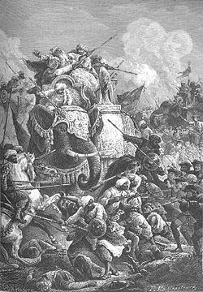
Second Carnatic War(1749-54)
Causes:
1. Disputed Succession at Hyderabad & Carnatic
Hyderabad: Muzzafar Jung (French) Vs Nazir Jung(English)
Carnatic: Chanda sahib(French) Vs Mohammed Ali (English)
2. Stringent Anglo- French Relations

Slide 9
Course of War
Battle of Amber (1749)
French & Chanda Sahib defeated Anwar –ud-din- and was killed
His illegitimate son Mohammed Ali refuge in Trichinoploy- Dupleix sent Chanda Sahib to capture Mohammed Ali
Nazir Jung was killed- 1750
Muzzaffer Jung- crowned as Nizam in Pondicherry- sent to Hyderbad accompanied by French officer Bussy
on his way Muzzafer Jung killed- Bussy throne Salabat Jung as new Nizam- stayed in Hyderbhad to guard him.

Slide 10
Chanda sahib was defeated by Clive in Battle of Arcot(1751)
Besieged at Trichy killed by Raja of Tanjore.
East India Company’s supporter Mohammed Ali became Nawab of Carnatic.
Dupleix was recalled by French in 1754- he followed by Godeheu-arranged peace treaty- both companies were agreed not to interfere in native matters
Treaty of Pondicherry(1754)
Results of Second carnatic War
Friend of English Mohammed Ali as Nawab of Carnatic

Slide 11
Third Carnatic War (1758-63)
Causes
Outbreak of Seven Year War in 1756- between England & France
Arrival of Count de Lally- 1758
Course of War
Count de Lally attacked Fort St. David- then he planned to attack madras- so he called Bussy from Hyderabad- great political blunder- soon after his departure – Clive sent- Col. Forde from Bengal- and – captured Northern Sircars (Hyderabad) from French

Slide 12
Battle of Wandiwash (1760)
English General Sir Eyre Coote , Defeat of Count de lally took Bussy prisoner- loss of Pondicherry (1761)
Treaty of Paris (1763)
French settlements in India were returned- restriction forced not to fortified-ended the military and political power of French in India.- This war ended French power and English became the only European force in the country.

